Slide 1
Why You Should Include a DPM
[Insert your name here]

Slide 2
Physicians, Surgeons, & Specialists
Education and training equivalent to allopathic and osteopathic physicians
Surgery including rearfoot and ankle
Specialists in the foot and ankle

Slide 3
Education & Training

Slide 4
Education & Training
Four years undergraduate
Four years at one of nine accredited schools of podiatric medicine
Mandatory, three-year, standardized Podiatric Medicine and Surgery Residency (PMSR)
Optional fellowship training

Slide 5
Licensure & Board Certification

Slide 6
Licensure & Board Certification
Licensed by the state in which we practice
Certification by American Board of Podiatric Medicine and American Board of Foot and Ankle Surgery

Slide 7
Scope of Practice

Slide 8
Scope of Practice
Authorized to practice by state statute
Regulated and licensed to practice in all 50 states and the District of Columbia
Scope is defined by the state
All but four states include the ankle in a podiatrist’s scope of practice
Defined as physicians by federal government and most states.

Slide 9
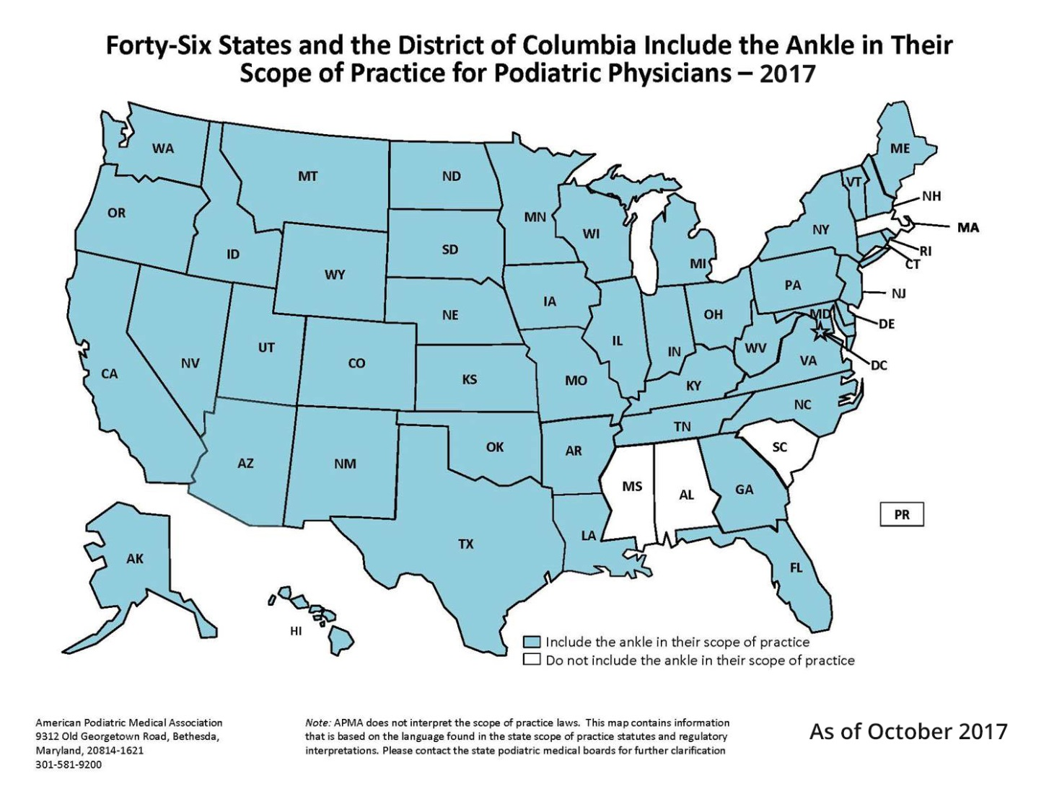
Scope of Practice

Slide 10
Sub-Specialization

Slide 11
Sub-Specialization
Wound care and diabetes
Geriatric care
Sports medicine
Surgery
Dermatology
Pediatrics
Biomechanics
And more

Slide 12
Common Ailments Podiatrists Diagnose & Treat

Slide 13
Podiatrists Diagnose & Treat…
Musculoskeletal conditions (e.g., bone & joint deformities, tumors, arthritis)
Traumatic injuries (fractures, open wounds, etc.)
Vascular conditions (e.g., PAD)
Dermatologic conditions (e.g., dermatitis, skin tumors, cicatrix)
Infections (bacterial, fungal, viral)
Endocrine disorders (e.g., diabetes)
Metabolic disorders (e.g., osteoporosis)
Neurologic conditions (e.g., neuropathy, neuralgia, neuritis)

Slide 14
Key Studies Demonstrating Value

Slide 15
Key Studies Demonstrating Value
An Economic Evaluation of the Impact, Cost, and Medicare Policy Implications of Chronic Nonhealing Wounds
Policy Brief: Podiatric Services Could Reduce Costs of Treating Diabetes Complications in CA by up to $97 Million
Foot in Wallet Disease

Slide 16
Key Findings

Slide 17
Key Findings
Medicare spending related to wound care is conservatively estimated at $31.7 billion
Patients with diabetes who see podiatrists are sicker & have more risk factors for foot ulcer/amputation prior to first visit
Patients aged 18-64 with diabetes & foot ulcer who see podiatrists have 29% lower odds of amputation & 24% lower odds of hospitalization
Patients aged 65-plus with diabetes and foot ulcer who see podiatrists have 23% lower odds of amputation & 14% lower odds of hospitalization

Slide 18
Key Findings
Care by podiatrists yields a positive ROI
In the population aged 18-64, each $1 invested in podiatry care results in $5.86 to $9.36 of savings
In the population 65-plus, each $1 invested in podiatry care results in $0.90 to $1.17 of savings
If every at-risk diabetic patient saw a podiatrist, the US health system could save $3.5 billion a year

Slide 19
Questions?
[Direct contact info here]

